Slide 1
Digital Marketing & Mobile
AliExpress of Alibaba group
Digital Marketing
Kevin

Slide 2
Agenda
Introduction of AliExpress & Alibaba group
Digital Marketing trends
AliExpress Mobile
Russian Market Operation
11.11

Slide 3
A Commerce Ecosystem
A Commerce Ecosystem
Online
marketing
Logistics infrastructure
(1)
O2O
(1)
Social
network
Financial Services
Other Participants
Digital Entertainment
Logistics Partners
Sellers
(2)
Buyers
Consumer protection program
Transaction safety program
Feedback & rating system
Rules of marketplace
TECHNOLOGY
DATA
TEAM
Alibaba online and mobile commerce infrastructure
Notes:
(1) Though minority investments or joint ventures
(2) Through contractual arrangements with Ant Financial Services Group, our related company that operates Alipay

Slide 4
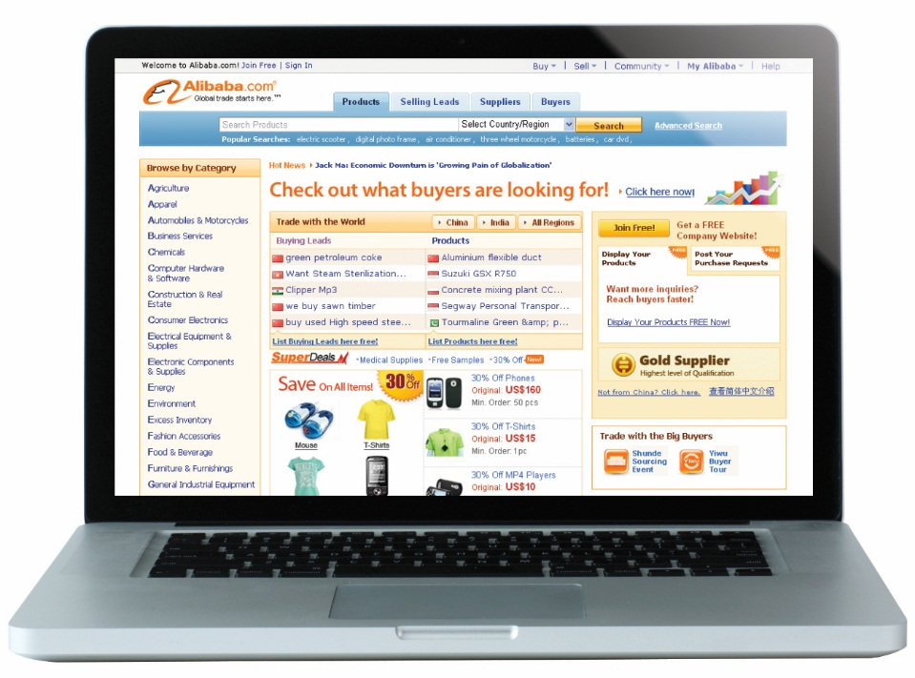
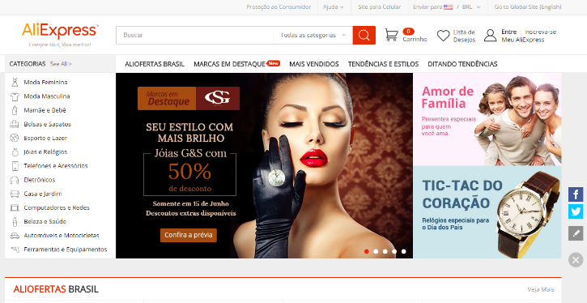
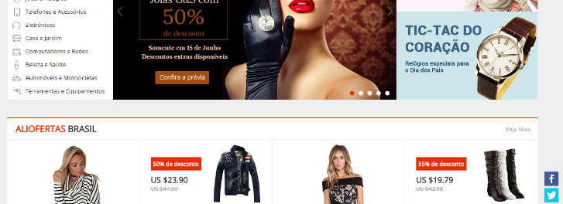
What Is AliExpress?
Launched in April 2010
Global retail marketplace targeted at consumers worldwide
Showcases a wide variety of products at competitive prices from Chinese wholesalers and manufacturers
Operates a global English-language site as well as local-language sites catered to Russian, Brazilian and Spanish consumers
Generated US$4.5 billion in GMV in the 12 months ended June 30, 2014
Best Rank: Top 25 on Alexa globally, and Top 9 for Russia.
AliExpress ships hundreds of thousands parcels per day, to more than 220 countries and regions.
Notes:
4

Slide 5
Agenda
Introduction of AliExpress & Alibaba group
Digital Marketing trends
AliExpress Mobile
Russian Market Operation
11.11

Slide 6
Why?
Seeds
Build up the initial user base
See whether the return is good enough to cover the marketing expense
Find out a carve that users will increase organically
Acceleration
Identify the real user profile
Provide them more incentive to convert
Grow market share
Maintain existing user and LTV

Slide 7
Pay for Value not Number
Advertiser Mind Set
Media Buy or Affiliation?
Publish a Product
Identify the potential Users
Find the right media
Get Feedbacks from the result
Optimize the Product functions
Publish a Product
Offering to the Media
Analysis on the quality
Adjust the creative
Optimize the channels

Slide 8
Cooperation
Marketing & Product Development
Advertiser
Product determine how to do marketing
Marketing help product development
Publisher
Help to provide the right value to their audience
Help to get the feedbacks
Media
Landing page
Product

Slide 9
Agenda
Introduction of AliExpress & Alibaba group
Digital Marketing trends
AliExpress Mobile
Russian Market Operation
11.11

Slide 10
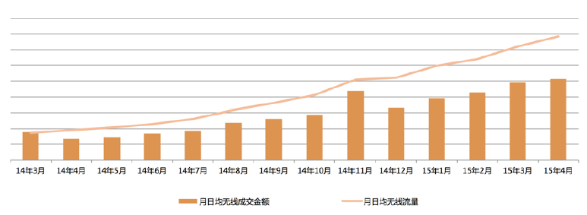
AliExpress APP
Start from 2011 AliExpress launched the first version of APP on Android market
From 2013, mobile transaction has been increased remarkbly
2014-2015, the YOY GMV has increased 500%
2015.8.25 promotion, the GMV increased 8 times than normal

Slide 11
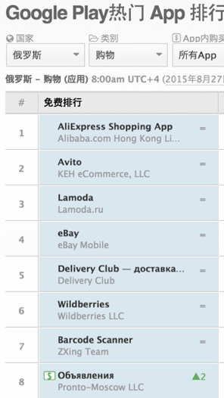
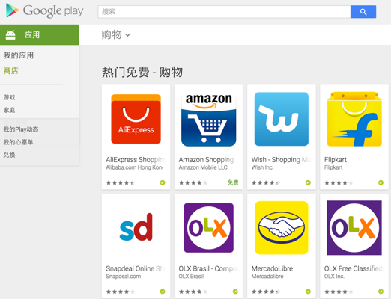
Success
Google Play ranking

Slide 12
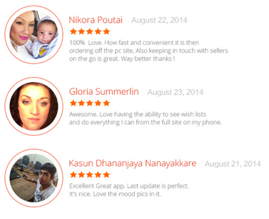
Change the life

Slide 13
Agenda
Introduction of AliExpress & Alibaba group
Digital Marketing trends
AliExpress Mobile
Russian Market Operation
11.11

Slide 14
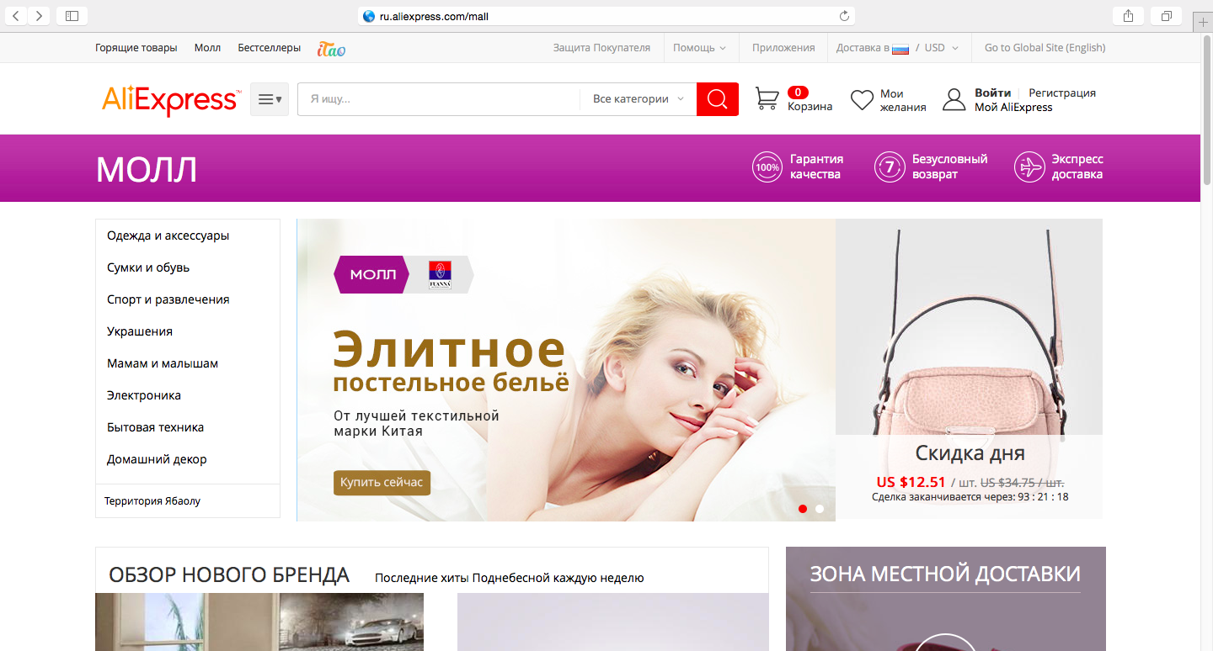
Mall is a new AliExpress strategy
Mall (ru.aliexpress.com/mall) – is a new platform of branded goods with extra quality quarantee and service. Launched in April 2015.
Mall Users - have higher demands for quality and service, also have a higher average check (2 times bigger than on AliExpress in general).
Mall sellers - are large and proven sellers from AliExpress that can offer extra service: quality guarantee, unconditional return and express-delivery.
НАШИ ПАРТНЁРЫ
Notes:
中国是全球最大消费品制造国与出口国，拥有巨大的供应链优势，中国制造已经进入欧美、包括俄罗斯大部分消费者的家庭，值得指出的是这个商品都是经过各国的品牌商，贸易商加了若干倍的价格销售到了消费者的手中，中国制造获取的只是微薄的利润。

Slide 15
Agenda
Introduction of AliExpress & Alibaba group
Digital Marketing trends
AliExpress Mobile
Russian Market Operation
11.11

Slide 16
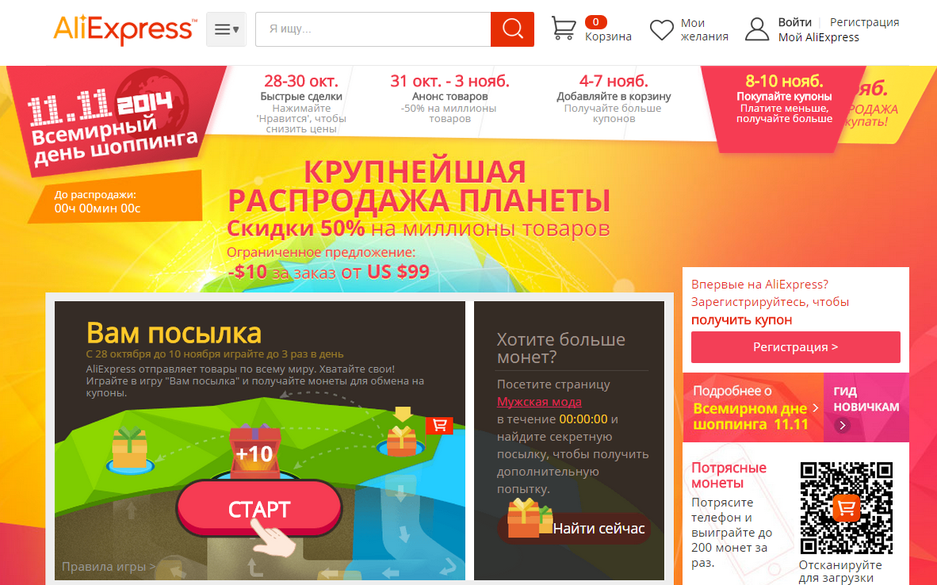
International shopping festival – 11th of November (11.11)
International shopping day - one of the biggest international sales that is hold annually by Alibaba Group on 11.11 since 2009.
Only 24 hours
Over 1 million of products with significant discounts.
Bigger that Black Friday and CyberMonday all together.
Daily volume in 2013 - $5,8 bliion, in 2014 $9,3 billion.
Notes:
中国是全球最大消费品制造国与出口国，拥有巨大的供应链优势，中国制造已经进入欧美、包括俄罗斯大部分消费者的家庭，值得指出的是这个商品都是经过各国的品牌商，贸易商加了若干倍的价格销售到了消费者的手中，中国制造获取的只是微薄的利润。

